Slide 1

ROBO NINJA ACADEMY
OFFFERS ACADEMIC PROGRAM 2024-2025

Slide 2
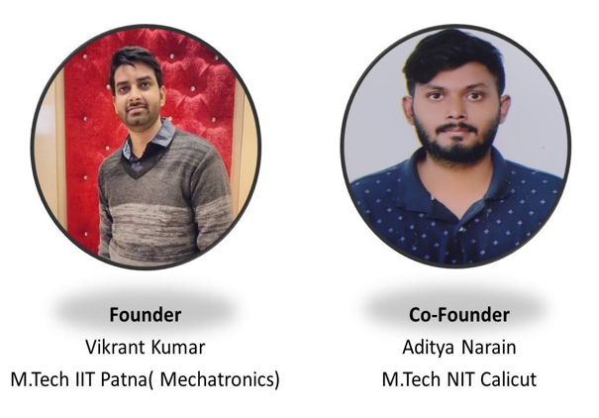

Slide 3
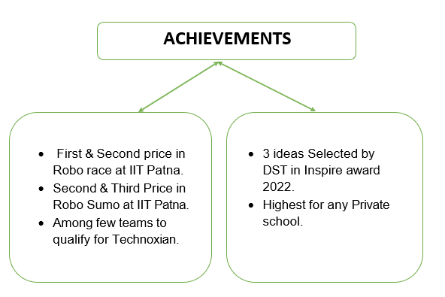

Slide 4
“What good is an idea if it remains an idea? Try. Experiment. Irritate. Fail. Try Again. Change the world”

Slide 5


21st century skills

Slide 6


How we can support them?

Slide 7
Our Achievements
Ideas of 4 students nominated for inspire awards and got funded by Department of science and Technology for its implementation.
1st, 2nd & 3rd position in Robo Race at IIT Patna.
2nd & 3rd position in Robo Sumo at IIT Patna.
3rd position in Robo Soccer at IIT Patna.
Participated at Technoxian(International Robotics competition) 2022 & 2023.

Slide 8

Experiential learning
Real World Project Based Learning
Hands on Learning
We learn from our Success; We learn from our Failures
Allows students to challenge the theory

Slide 9


CLASS- WISE PLANNER (3RD -5TH)
S.No | Module | 3rd | 4th | 5th
1. | Avishkaar Block programming Kit
2. | Scratch programming
3. | Circuit board
4. | Chemistry kit
5. | DIY Robotics

Slide 10
CLASS- WISE PLANNER(6TH -12TH)
S.No | Module | 6TH | 7TH | 8TH | 9TH | 10TH | 11TH | 12TH
1 | Scratch
2 | Artificial Intelligence
3 | Arduino
4 | Python
5 | Circuit Board Adv.
6 | 3D-Printer
7 | Drones

Slide 11
SCHOOLS AND COMPANY RESPONSIBLITIES
SCHOOL SIDE
OUR SIDE
Dedicated Space
Dedicated Trainers & Kits
Internet Facility
Training For Robotics Competitions
Speakers and Projector
Digitized Training Curriculum
Authorized Certificates

Slide 12
ADDITIONAL OFFERINGS
Robo Ninja Academy Authorized certificates.
Monthly Challenges.
Competition based trainings and Curriculum.
Regular Updated curriculum on latest technologies.
Participation in Robo Ninja Academy National Level Competition.
3D-Printer and Drones Challenges and competition officially by Robo Ninja Academy.

Slide 13
TERMS AND CONDITION
School management needs to fix the days of these classes.
No kit will be sold out under Academic proposal.
RoboNinja Academy will provide the kits for classroom activity.
Note: All agreed points will be duly signed and stamped by both parties for the conclusion of the deal.

Slide 14

















Naval's National Academy, Gorakhpur
OUR CLIENTS
Doon Public School, Gorakhpur
teachers and parents.
Green Field’s School, Maujpur
Moradabad Institute of Technology
Bal Bharti School, Delhi

Slide 15
Package
S.No | Module Name | Classes | Batch Size | Fee /month
1 | All Modules | 3rd – 12th | Section wise | As per strength
The fee includes-
Cost of 2 trainers
Cost of Kits
1 weekly classes for each section

Slide 16

GORAKHPUR OFFICE ADDRESS – 1st floor, Pyyare complex, Fatima Road , Gorakhpur
NCR OFFICE ADDRESS – H. NO- 676, Sector 17A, Gurugram
Name of Person – Mr. Aditya Narain
Contact No- 7007326026
Email- roboninjaacademy@gmail.com

